Slide 1





Slide 2

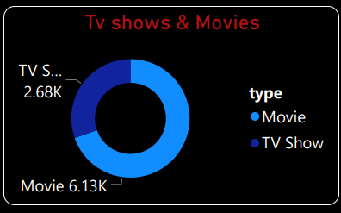
Netflix hosts over 8,800 titles, with a strong bias towards movies.
Movies dominate the platform with 6,130+ titles, making up 70% of the entire catalog.
TV Shows, though fewer at 2,680+, still form a critical part of Netflix’s binge-watch appeal.
This split highlights Netflix’s cinema-first approach, while also investing heavily in series to retain subscribers.

Slide 3
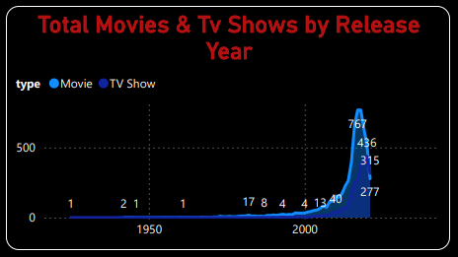
Exponential content growth began around 2010, with a huge spike post-2015.
2020 was the peak release year with 767 titles.
Movies consistently dominate each year, but TV shows have also grown significantly.
Minimal releases pre-2000 show Netflix’s modern, digital-first strategy.

Slide 4
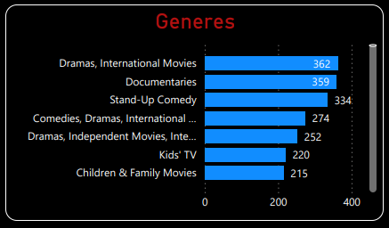
Dramas & International Movies are the top genre combination with 362 titles, indicating high global and emotional appeal.
Documentaries (359) are nearly tied with dramas — showcasing Netflix’s strong push in real-world, factual storytelling.
Stand-Up Comedy ranks 3rd (334), proving Netflix’s influence in the comedy special space.
Mixed genre titles like “Comedies, Dramas, International” (274) reflect Netflix's blended storytelling approach.
Content for Kids and Families is also notable, with 220+ children’s titles and 215+ family movies.

Slide 5
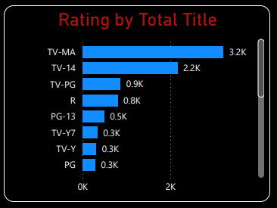
TV-MA (Mature Audience) dominates with 3.2K titles, suggesting Netflix caters primarily to adult audiences.
TV-14 is the second most common, at 2.2K titles, appealing to teenagers and families with older kids.
Family-friendly ratings like TV-Y, PG, and TV-Y7 are fewer, each under 0.3K, showing less content for young children.
R-rated and PG-13 titles appear modestly, likely due to licensing rather than Netflix Originals.

Slide 6
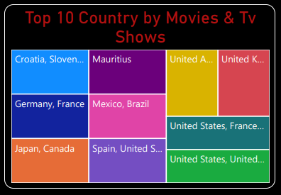
The United States appears multiple times, often in combination with other countries like France and the United Kingdom, indicating strong co-productions or shared licenses.
European nations such as Germany, France, Croatia, and Slovenia are key contributors, showcasing the rising popularity of European content.
Interestingly, we also see diverse regions like Japan, Canada, Mexico, Brazil, and Mauritius, reflecting Netflix’s global expansion strategy and regional content development.
This visualization highlights how Netflix has diversified its library across countries, promoting international storytelling and catering to a wide range of cultural tastes.

